Slide 1
Basic printing/slicing
By Friend

Slide 2
Pre-workshop
Watch: 3D printing overview https://www.youtube.com/watch?v=f5fBwppxtkI
Watch: Fused Deposition Modelling (FDM) Process https://www.youtube.com/watch?v=J4OQQ9bA6g0
Watch: Original Prusa i3 MK3 guide for a new user https://www.youtube.com/watch?v=GE-lrRbU124

Slide 3
Pre-workshop
Download and install:
Cura https://ultimaker.com/en/products/ultimaker-cura-software
Github Desktop https://desktop.github.com
Make a Github account

Slide 4
If there’s a word you don’t understand in the slide, let me know and I’ll add it here

Slide 5
Agenda
3D printing overview
Slicing
Starting a print on the printer
Cleaning the bed / sanding
General good practice
First layer importance
Printed solid
Troubleshooting

Slide 6
Part 1: on the computer

Slide 7
Quiz #1
(to get over the boring stuff)
What is 3D printing?
What is FDM?
What is slicing?

Slide 8
Answer #1
3D printing is rapid prototyping method, mostly used in industry to save time and money
FDM is a way to 3D print, by layering plastic on top of each other
Slicing cuts a 3D model into a set of 2D layers for FDM

Slide 9
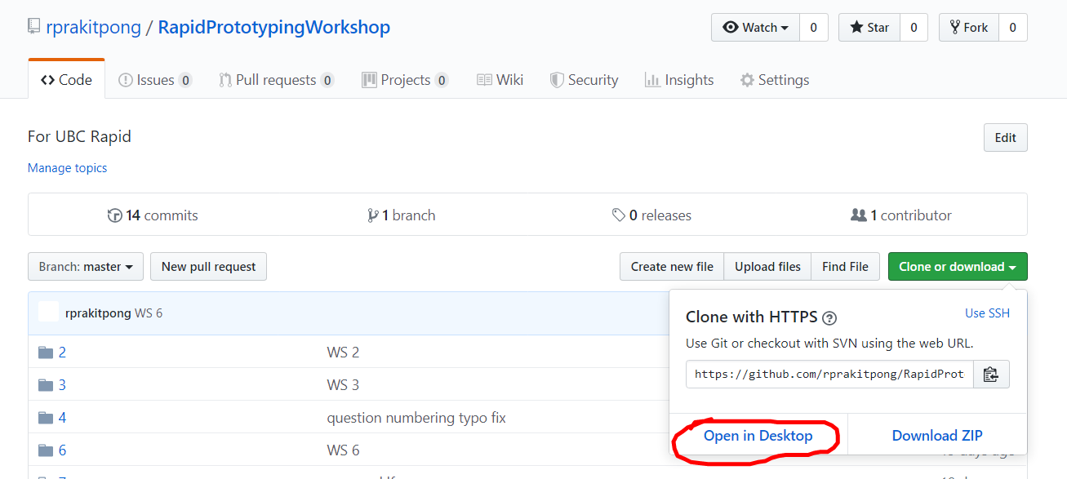
Get repo
There’s two repo I want you to get today
https://github.com/UBC-Rapid/Cura-settings
https://github.com/rprakitpong/RapidPrototypingWorkshop
Click on the green button -> [Open in Desktop]
Github Desktop should pop up and you can click along to get download the whole repository to your laptop
If this is the first time you open Github Desktop, you’ll be prompted to log in

Slide 10
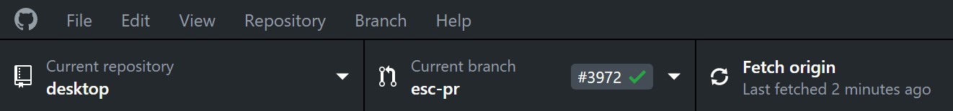
Get repo
These repo act exactly like normal folders and files to you
I encourage you to read ahead on workshops if you have time
Click [Fetch Origin] occasionally to update your local repos

Slide 11
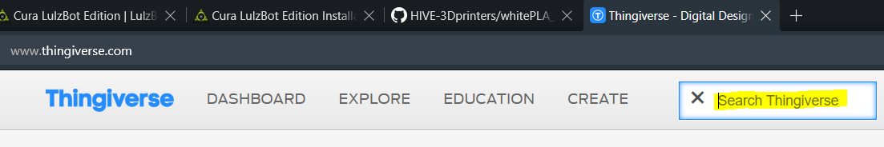
Find a model
You’ll get to print a small model today (yays!)
Go to “thingiverse.com”
Search for something you want
Some ideas: pen cap, loaded dice, lowpoly dog, low poly dog, utility knife, cable clip, cable wrapper

Slide 12
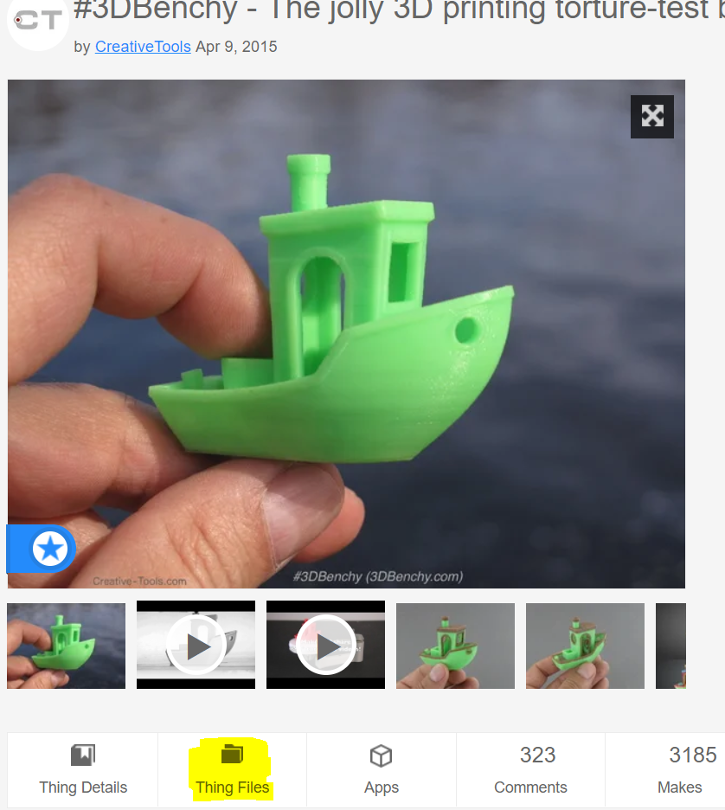
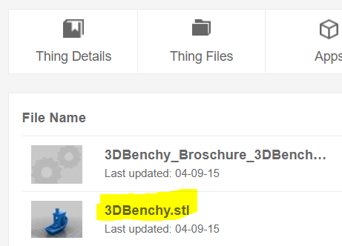
Find a model
Once you click on the thing you want, scroll down and click on “Thing Files”
Get just the model you want
Sometimes if you blindly download you’ll get a huge zip file with everything

Slide 13
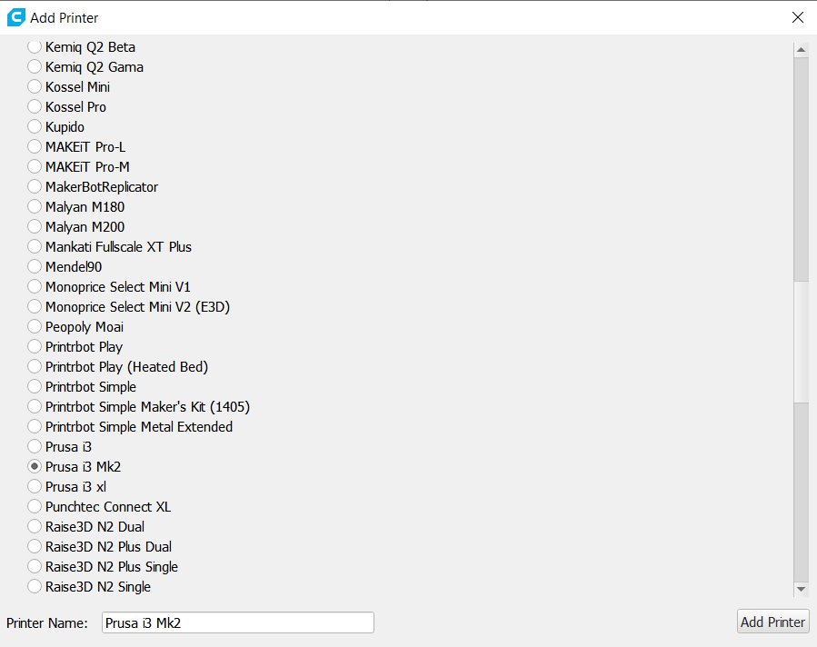
Cura
Opening Cura for the first time should let you add a printer
Select Prusa i3 Mk2

Slide 14
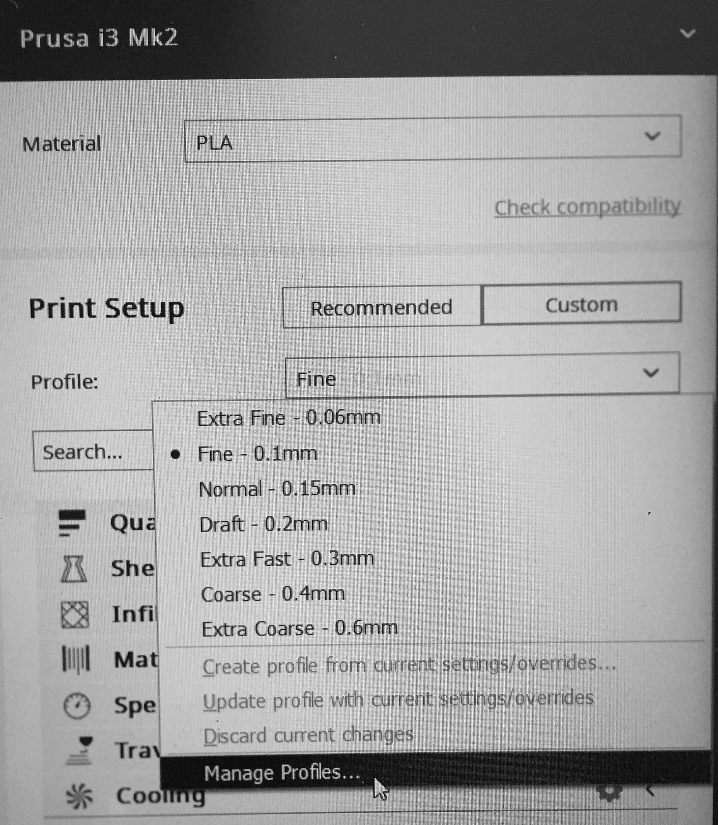
Cura
We’re going to change print profile to what the team has tested
Click [Custom]
Click [Profile] -> [Manage Profiles]

Slide 15
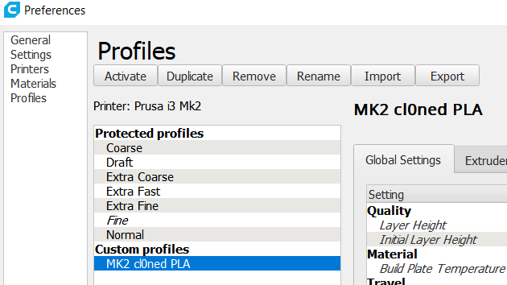
Cura
Click [Import]
Find the profile “MK2 Cl0ned PLA” and import it
Or profile for other printer
I’ll tell you which profile to import
Select the profile and click [Activate]

Slide 16
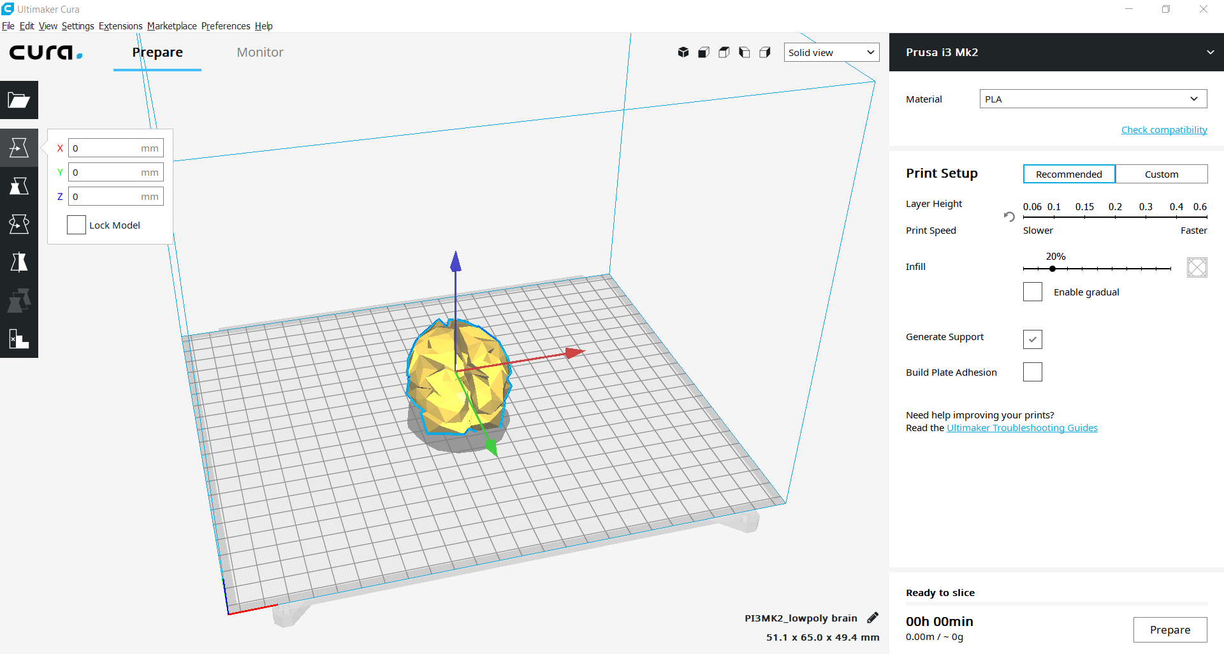
Cura
Click on the folder icon on top left to import a model
Select the model you downloaded earlier
Right mouse drag to rotate camera, middle mouse drag to translate camera
Click on the model to select it for manipulation
Below folder icon are the tools to manipulate the model
Try out a few of them
It’s too simple for me to go over them

Slide 17
Cura
Switch back to recommended print setup
Stick to recommended for now since it’s all preset by the profile you just import
I highly encourage you to look at the custom settings and see what you can customize for the printer through software

Slide 18
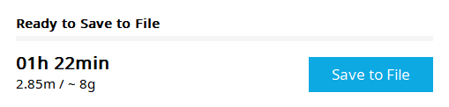
Cura
Click [Prepare] to slice the model
Make sure the model you’ve found doesn’t exceed 15g
Don’t be wasteful!
You can hover over time and material use to see in depth stats
Cura likes to give underestimate for time though
Do that time multiplied by 1.25 as a ballpark
Click [Save to File] to save it to an SD card
I’ll pass one around

Slide 19
Quiz #1.5
If you increase length by twice, and the model is uniformly scaled, by how much does the volume increase?

Slide 20
Answer #1.5
8 times (2^3)

Slide 21
Part 2: on the printer

Slide 22
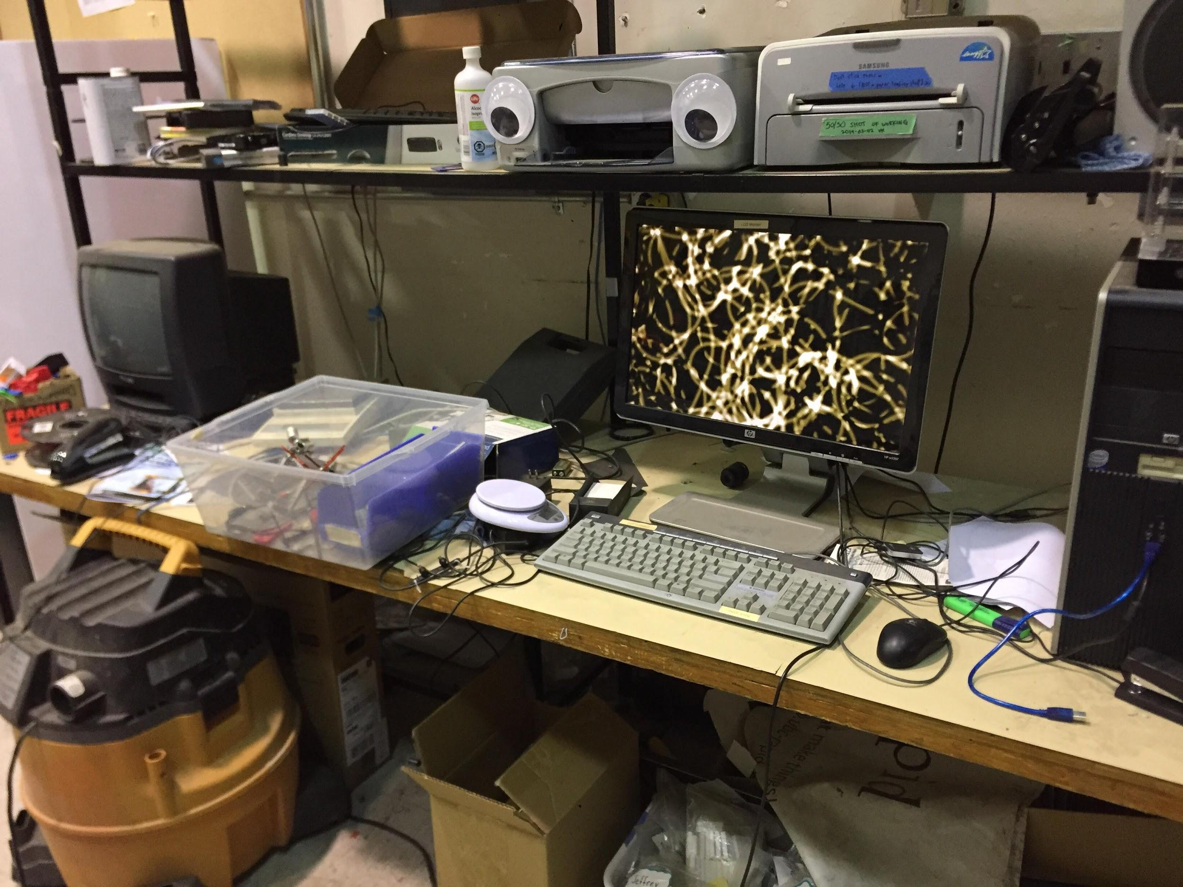
Space tour
Team desktop
There’s Cura with all the settings on here

Slide 23
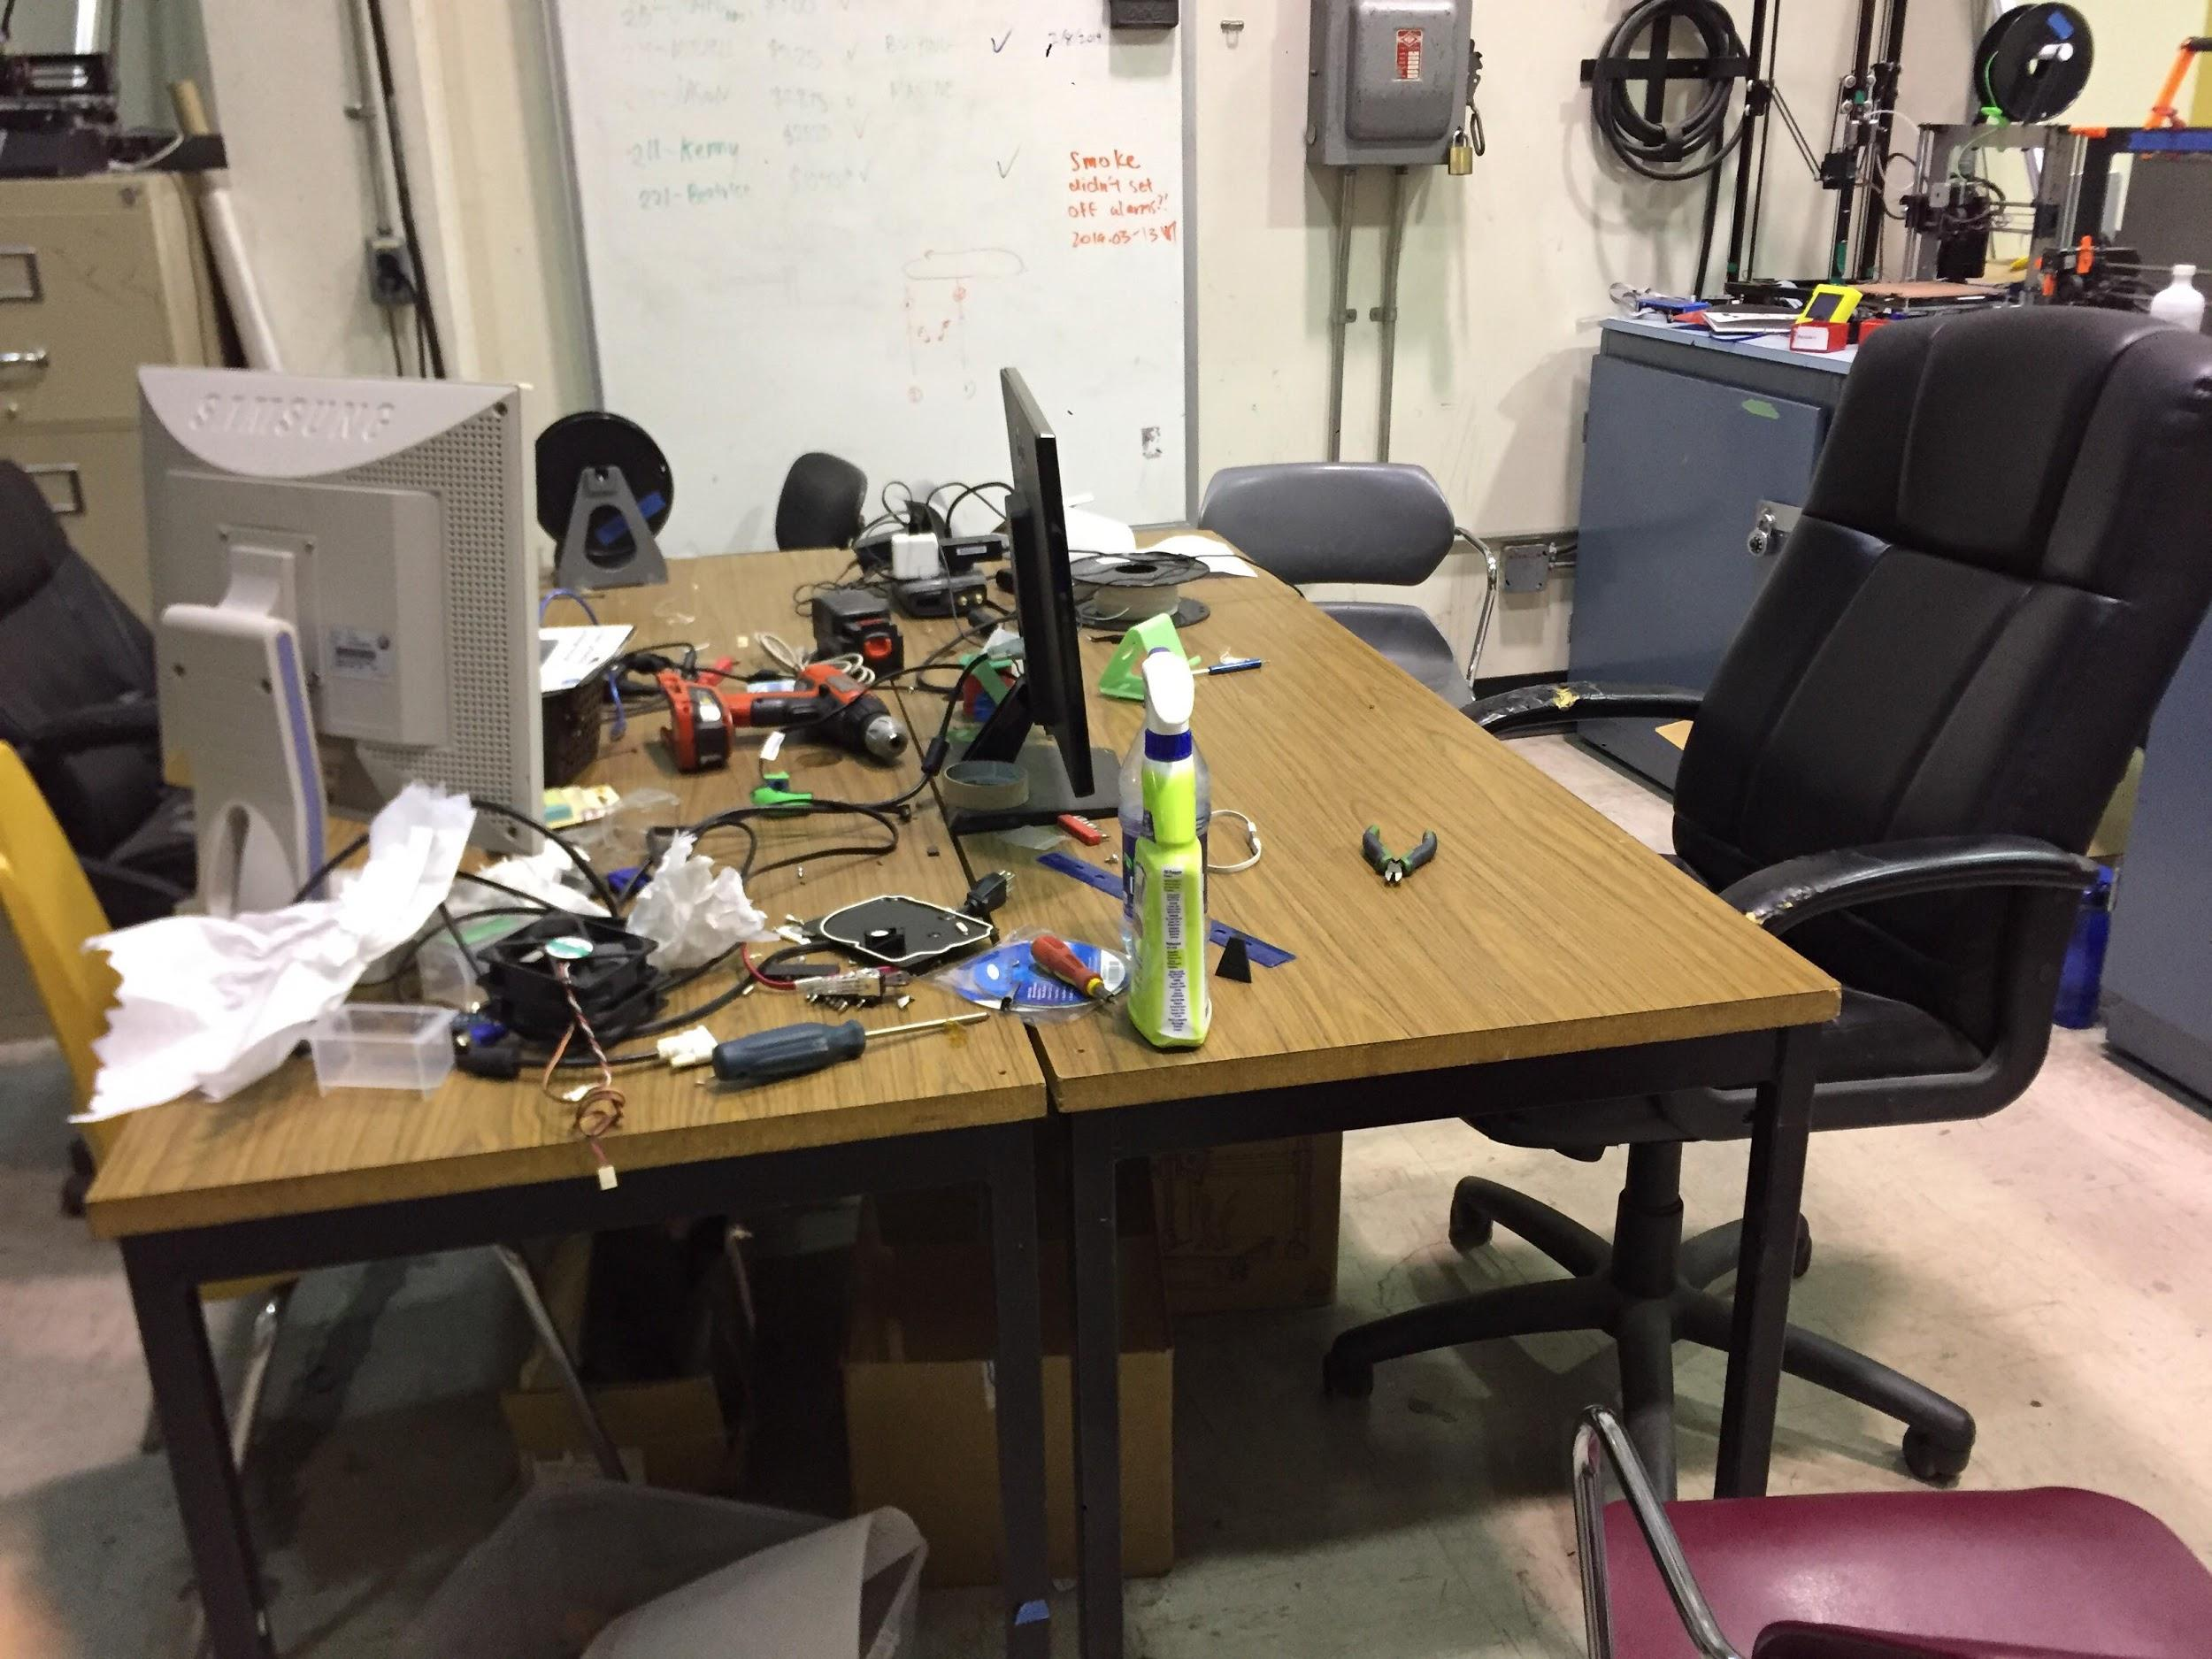
Space tour
Work bench
Make sure it’s clean after you use it
So not looking like this lol

Slide 24
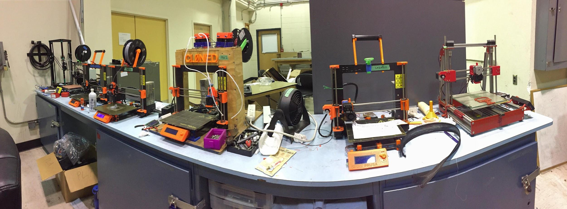
Space tour
Our printers
You’re free to use it for your own personal projects
You’ll use them throughout the workshops
You can keep things in cabinets
Ask for passcode from execs

Slide 25
Space tour
Tools cabinet
Put things back when you’re done

Slide 26
Note
Wear PPE
Don’t eat in the space
Clean up after yourself

Slide 27
Quiz #2
(to get over the boring stuff)
How do you measure the proper gap between first layer and printer bed?
What type of alcohol do you clean the bed with?

Slide 28
Answer #2
A sheet of paper
Isopropyl alcohol

Slide 29
Using the printer
Turn it on
Clean bed as needed
Put in SD card
Scroll to your gcode file
Preheat (or auto preheat)
Calibrate (or auto calibrate)
Watch until the first layer is done
No point in explaining more, I’ll show you once and let you do your own

Slide 30
Your turn
Before the next workshop or right after this workshop is done, I’ll let you into this space to print the model you sliced
You’ll clean bed/print successfully without my help
You can use online references though
Prusa Mk3 Guide video I made you watch before this workshop is a good resource

Slide 31
Troubleshooting
You’ll learn as you use the printer more
Simply: if it sounds unusual, if it vibrates, if something pops off, turn off the printer (red power switch) because something’s wrong
Google is your friend, but know when to stop
If it’s getting too complicated, put the issue on Slack, and ask senior members to help you with it
Examples of issue getting too much: you have to get inside control box to fix, takes more than a day, you need power tools, etc.
Doesn’t mean you’re off the hook, it just means you need to ask for help
Don’t break things too much
You’ll be that senior member fixing stuff newbies break

Slide 32
Some further readings
By the time this workshop ends, I’ll have put up a list of active projects and who the lead on that is
Use the project name as keywords and Google about it
As a member you’ll take part in projects, so it’s good to think a bit ahead
Take a brief look at the projects ideas slides in this repository
You’ll do a short project / work on a Rapid project at the end of workshops, so it’s good to see ahead and know what type of project you’ll do for which workshop you like

